Slide 1


E-Science: The Impact of Science DMZs on Research
Presenter: Alex Berryman
Performance Engineer, OARnet
berryman@oar.net
Paul Schopis, Marcio Faerman
OARnet, Ohio Supercomputer Center

Slide 2
Context and Motivation
The goal of the NSF CC-NIE project is to improve the last mile connectivity for e-Science applications that exists all over campus
  The last mile is considered the area of the network that extends from the Universities central IT level down to the individual departments
  A large number of e-Science applications exist out side of data centers and labs where high speed connections are normally found

Slide 3
Areas of Impact
The e-Science applications that benefit from the Science DMZ architecture are those that involve interactive collaboration tools and local visualization of data
Medicine
  Remote physical therapist conducting exercises with patients removing the need to travel.
  Collaborative review and processing of patient records
Physics
  Remote instrumentation and control of electron microscopes from the classroom
  Transfer simulation data from supercomputer center to lab workstations for better interactive visualization

Slide 4
Collaboration Efforts
Brazil Gateway with the Ohio State University
  Project between University of Sao Paulo and OSU
    Prof. Tereza Carvalho, LARC USP
  Gathering current baseline of network performance using perfSONAR monitoring
  Evaluate the interoperability of US and Brazil Science DMZs
    Dynamic Layer 2 circuits compatibility will be tested
  More info http://oia.osu.edu/brazil.html

Slide 5
Role of the Performance Engineer
The purpose of the Science DMZ is to accelerate the research efforts on campus, not just build faster networks
e-Science applications rely on interconnectivity of multiple domains and layers that can effect performance
  Is this a hardware or network issue?
  Network path: Department -> Central -> Regional -> National -> International Networks
The performance engineer is a resource for researchers to troubleshoot current issues and in planning future research proposals

Slide 6
Science DMZ Design at OSU
Two Connection Models:
  Low Friction Layer 3
  Layer 2 Circuit (AL2S)
Component:
  Cisco Nexus 7000 (100Gig)
  NEC PF5820 (40Gig)
  Campus OpenFlow Switches (10Gig)
  Data Transfer Node (10Gig)
Notes:
On the left you see out high level topology.
OSU is comprised of individual departmental IT groups, and a Central IT group.
Most researchers just need a cleaner layer 3 path to the outside world, some have more requirements.
This is why we have two connection models the Low Friction Layer 3 path where we remove stateful firewalls and replace with OpenFlow policy controlled switches.
For the other groups with more requirements we are building layer 2 circuits
As a campus we are connected to OARnet at 100Gig, with a science DMZ switch that is capable of 40Gig, and multiple campus switches that operate at 10Gig

Slide 7
Connection Models
Low-Friction Layer 3 connectivity
  Separate business (email, grades) traffic from research flows. This allows research traffic to bypass the firewalls that are required for day-to-day operations in a normal network
  Useful in applications that support normal TCP/IP traffic
Dynamic Layer 2 Circuits
  Some applications only work layer 2
    Emerging data transfer protocols (RoCE)
    GENI dataplane connectivity
    Remote Instrumentation tools

Slide 8
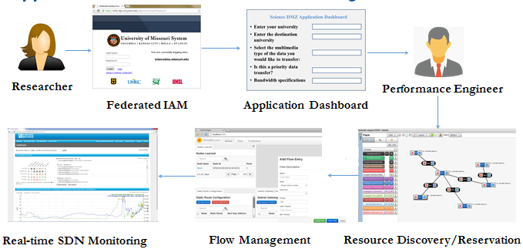
Researcher Network-as-a-Service Dashboard
Researcher uses Shibboleth credentials to define Application and end points. Researchers also classify the data’s privacy type.
After approval, Performance Engineer pushes endpoint info into a RESTful API that is polled by OpenFlow controller.
Real-time software defined network monitoring of critical network parameters for bottleneck identification and troubleshooting
Notes:
In order to maintain an audit trail for Science DMZ I am developing a Network-as-a-Service dashboard.
This process starts with a shibboleth authenticated user defining there application traffic and classifying the type of data they will be exchanging.
This information is then reviewed and approved up the chain of department -> central IT groups. The performance engineer then pushes the flow information to an API that is queried by the Openflow controller.
This will also trigger automatic monitoring of utilization and security scans.
Our first group that is benefiting from this service is a group from our Mechanical Engineering department.
----- Meeting Notes (9/3/14 11:18) -----
Software defined permimeter

Slide 9
Multi-physics Use Case (Low Friction Layer 3)
Researchers in OSU’s ME Department move large files to and from HPC at WPAFB in Dayton, OH. (80 Miles West of Central Ohio)
Problems were discovered at different layers:
  Transfers of 80Gb files take over 12 hours
  Hosts are using shared and firewalled 1Gig connection
  The DREN path was not being correctly advertised to OSU by OARnet and was going all the way to Los Angeles
  Researchers are using SCP
Planned Actions:
  Use OpenFlow to switch research traffic onto a non-firewalled dedicated fiber to OSU core
  Correct BGP Peering so OSU uses OARnet’s direct connection to DREN
  Still using SCP due to lack of control on DoD HPC side
Transfers currently take under two hours, but we are working of improving this further.
Notes:
Student Researchers we waiting 12hrs overnight

Slide 10
Multi-physics Topology (Low Friction Layer 3)

Slide 11
Biomedical Use Case (Layer 2 Circuit)
Transfer Neuroblastoma cell images from University of Missouri for processing at OSU using custom ADTS tool:
  Supports RDMA over converged Ethernet (RoCE)
  Falls back to TCP based transfers if necessary
RoCE Protocol Requirements:
Layer 2 Connection
RDMA compatible network cards
10Gig bandwidth
Lowest latency possible
Notes:
This use case requires our “Layer 2 Circuit” connection model due to the tool’s use of a RDMA based protocol.
The bandwidth utilization is able to saturate a 10Gig link during the short periods of time that image tile sets are being transferred. Since there is an interactive nature between the endpoints the protocol is somewhat effected by latency.
Our next use has much tighter constraints.

Slide 12
Science DMZ Security
Real time utilization and event monitoring using sFlow
If sFlow detects an event the traffic flow is mirrored to a Bro Cluster for packet inspection
  Bro Cluster is a capable of monitoring ~40Gbit/s
  Once a flow from the 100Gbit link is deemed safe, or not malicious it can be removed from the Bro Cluster
All flows are tied to an application in Science DMZ Dashboard
  This dashboard maintains the identity of application owner and who approved the access incase security concerns arise
Notes:
----- Meeting Notes (3/6/14 16:53) -----
Host Logs

Slide 13
Thank you!
Questions?
Contact
  Alex Berryman, Performance Engineer, OARnet
  berryman@oar.net

